Slide 1
UdeSA Financial Engineering Course
The Variance Risk Premium
as a Return Predictor
Replication of Bollerslev, Tauchen & Zhou (2009)
Expected Stock Returns and Variance Risk Premia, Review of Financial Studies 22(11), 2009
VRP = IV − RV = VIX²/12 − Σr²_d (variance risk premium construction)
Epstein–Zin recursive preferences: why volatility-of-volatility creates return predictability
Horizon regressions h = 1–24 months with Newey–West standard errors
Sign reversal in 2008–2026: the paper’s result does not survive out-of-sample
Lecture 07 · 90 minutes
1 / 32

Slide 2
Financial Engineering · Lecture 07
Course Roadmap
Course Roadmap
1
Theory
The VRP definition and its equilibrium foundations (Epstein–Zin)
2
Signal Construction
Computing IV, RV, and VRP from daily SPX and VIX data
3
Statistical Validation
Horizon regressions, sign reversal, and outlier diagnostics
4
Position Sizing
Translating VRP into binary and scaled trading signals
5
Backtest
Cumulative returns, Sharpe ratio, and drawdown analysis
6
Paper Comparison
Table 2 replication: our slopes vs. the paper’s slopes
7
Robustness Checks
Ex-Oct-2008, volatility form, and HAR-RV expected VRP
8
Honest Assessment
What the data supports and what it does not
Bollerslev, Tauchen & Zhou (2009) · Rev. Financial Studies 22(11)
2 / 32

Slide 3
1
Theory
The VRP and Its Equilibrium Foundations
3 / 32

Slide 4
Financial Engineering · Lecture 07
1. Theory
What Is the Variance Risk Premium?
The VRP: Plain-Language Definition
8.99 %²
85.2%
The VIX is the market’s price of variance insurance
Variance swap: pay IV today, receive RV that materialises
If IV > RV consistently, investors pay a fear premium
VRPₜ = IVₜ − RVₜ (positive = market over-prices variance)
Mean VRP (2008–2026)
Months with VRP > 0
−0.10
47.3 %²
VRP AR(1) [paper: 0.49]
VRP Std Dev [paper: 15.1]
Key Formula
VRPₜ = IVₜ − RVₜ
IVₜ = VIX²ₜ / 12 (%²/month)
RVₜ = Σᵈ [100 × ln(Pᵈ/Pᵈ₋₁)]²
Units: %² per month (variance, not volatility)
Our Sample vs. Paper
Paper (1990–2007): mean VRP = 18.30, AR(1) = 0.49 — persistent signal
Ours (2008–2026): mean VRP = 8.99, AR(1) = −0.10 — near-random walk
Two crises (2008, 2020) dominate the distribution
Bollerslev, Tauchen & Zhou (2009) · Rev. Financial Studies 22(11)
4 / 32

Slide 5
Financial Engineering · Lecture 07
1. Theory
Why Does VRP Predict Returns? Epstein–Zin Theory
Equity Premium Decomposition (Bollerslev et al. Eq. 11)
π_r,t = γσ²_{g,t} + (1−θ)κ¹(A_q²φ_q² + A_σ²) × q_t
[consumption risk] + [volatility-of-volatility risk]
q_t = volatility of the variance process | γ = risk aversion | θ = EIS parameter
The VRP Isolates q_t
Why the Quarterly Horizon?
VRP_t = Eᵀ(RV_{t+1}) − E(RV_{t+1}) measures the risk-neutral vs. physical variance gap
This gap is exactly proportional to q_t (vol-of-vol), the premium’s second term
VRP → q_t → equity premium: the causal chain is theory-based
At h=1: too noisy — monthly returns have low signal-to-noise
At h=3: optimal — within q_t persistence window, noise averaged
At h=12: q_t persistence fades, signal decays toward zero
Paper peak: h=3, t=2.86, R²=6.82%
Model Assumptions (and Our Departures)
Model requires: (1) EZ preferences with IES > 1 and risk aversion > 1, (2) stochastic vol-of-vol process q_t, (3) persistent VRP (AR1 ≈ 0.5)
Our data: VRP AR1 = −0.10 — near-zero persistence violates assumption (3). The model’s prediction is conditional on q_t being persistent.
Bollerslev, Tauchen & Zhou (2009) · Rev. Financial Studies 22(11)
5 / 32

Slide 6
Financial Engineering · Lecture 07
1. Theory
Paper’s Key Findings and What We Can Replicate
Horizon h | Slope b₁ | t-stat (NW) | Adj. R² | Interpretation
1 month | 0.39 | 1.76 | 1.07% | Weakly positive
3 months | +0.47 | +2.86 | 6.82% | PEAK — strong quarterly signal
6 months | 0.30 | 2.15 | 5.42% | Significant but fading
12 months | 0.12 | 1.00 | 1.23% | Weak, near zero
What We CAN Replicate
What We CANNOT Replicate
VRP construction methodology (IV and RV formulas)
Horizon regression framework (Equation 17)
Qualitative structure of the test (NW standard errors)
1990–2007 sample: SPX data starts Oct 28, 2008
5-minute intraday RV: we have daily data only
216 months of paper’s calm, persistent VRP regime
Bollerslev, Tauchen & Zhou (2009) · Rev. Financial Studies 22(11)
6 / 32

Slide 7
2
Signal Construction
Computing IV, RV, and the Variance Risk Premium
7 / 32

Slide 8
Financial Engineering · Lecture 07
2. Signal Construction
Data Sources and Sample Coverage
Dataset | Coverage | Role in Analysis | Key Limitation
spx_prices.parquet | Oct 28 2008 – Feb 2026 | Monthly RV via daily log-returns | Starts mid-crisis; Oct 2008 = 4 days only
vix_historical.parquet | Jan 2000 – Mar 2026 | Monthly IV = VIX²/12 | End-of-month sampling discards intra-month path
interest_rates.parquet | 1954 – 2026 | Risk-free rate proxy (Fed Funds / 12) | Policy rate ≠ 3-month T-bill (paper’s rate)
209
Oct 2008
4 days
Feb 2026
months in sample
start (vs. 1990 in paper)
Oct 2008 trading days
end of sample
Critical Data Artifact — October 2008
Our SPX series starts Oct 28, 2008. That month has only 4 trading days → RV = 10.1 %² (artificially tiny).
VIX closed at 59 that month → IV = 59²/12 = 290. VRP = +289 %² — the highest in our sample, but entirely a data artifact.
Bollerslev, Tauchen & Zhou (2009) · Rev. Financial Studies 22(11)
8 / 32

Slide 9
Financial Engineering · Lecture 07
2. Signal Construction
Realized Variance and Implied Variance: Construction
Realized Variance (Daily Approximation)
Implied Variance (from VIX)
RVₜ = Σ_{d ∈ month t} [100 × ln(P_d / P_{d-1})]²
Units: %² per month
Paper: 5-min intraday, n = 22 × 78 = 1,716 obs
Ours: daily closes, n ≈ 22 obs per month
Our mean RV = 29.52 %² vs paper 14.93 %²
IVₜ = VIX²_{t, EOM} / 12
VIX = annualized implied vol in %
VIX = 20 ⇒ IV = 400/12 = 33.3 %²/mo
Paper mean IV = 33.23 (1990–2007)
Our mean IV = 38.50 (2008–2026)
End-of-month sampling (last VIX close)
Why Daily RV is Noisier
Unit Reconciliation (Both in %²/month)
22 observations vs 1,716 — sampling variance is ≈75× higher
October 2008 artifact (4 obs) would be impossible with 5-min data
Microstructure noise is not an issue at daily frequency
VIX²/12 ⇒ annualized %² ÷ 12 = monthly %² ✓
Eq. (22): VRPₜ = VIX²_{t}/12 − Σ_{d ∈ t} r²_{d,%}
Both terms in identical units — no scaling needed
No-Lookahead Check
VRPₜ uses only VIX and SPX prices within month t — fully known at month-end t, before t+1 begins.
Regression: forward return at t+1 on VRPₜ at t. Position computed at t applied to return at t+1. ✓
Bollerslev, Tauchen & Zhou (2009) · Rev. Financial Studies 22(11)
9 / 32

Slide 10
Financial Engineering · Lecture 07
2. Signal Construction
VRP Assembly and Summary Statistics vs. Paper
Key Formulas
VRPₜ = IVₜ − RVₜ = VIX²_t / 12 − Σ_{d ∈ t} r²_{d,%}
Rᵉ_{t+1} = ln(SPX_{t+1} / SPX_t) − r_{f,t} (monthly excess return)
Variable | Our Mean | Paper Mean | Our Std | Paper Std | Our AR(1) | Paper AR(1)
Excess Ret. (ann. %) | 10.08 | 6.44 | 51.50 | 47.19 | −0.08 | −0.03
VRP (%²/mo) | 8.99 | 18.30 | 47.33 | 15.13 | −0.10 | 0.49
IV (%²/mo) | 38.50 | 33.23 | 40.44 | 23.73 | 0.78 | 0.79
RV (%²/mo) | 29.52 | 14.93 | 63.95 | 15.25 | 0.30 | 0.70
Key Differences Driving Failed Replication
VRP AR(1) = −0.10 (ours) vs 0.49 (paper): the signal has no persistence. Each month is essentially independent.
RV std = 63.95 (ours) vs 15.25 (paper): dominated by the March 2020 extreme (RV = 747 %²).
Bollerslev, Tauchen & Zhou (2009) · Rev. Financial Studies 22(11)
10 / 32

Slide 11
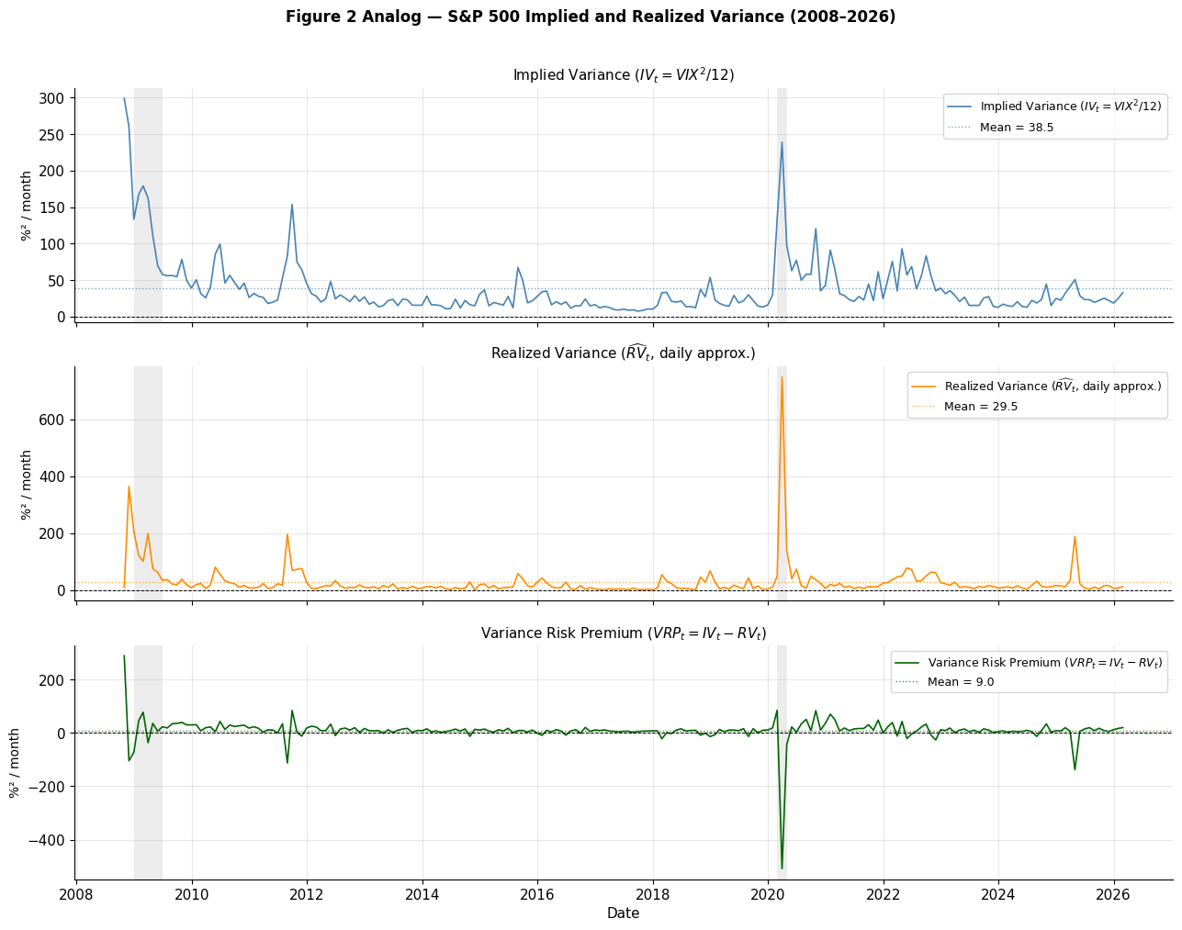
Financial Engineering · Lecture 07
2. Signal Construction
Implied Variance, Realized Variance, and VRP Over Time (2008–2026)
Fig. 2 analog: IV (top) = VIX²/12; RV (mid) = daily approximation; VRP (bottom) = IV − RV. Grey shading = NBER recessions. Dashed line = sample mean.
Bollerslev, Tauchen & Zhou (2009) · Rev. Financial Studies 22(11)
11 / 32

Slide 12
3
Statistical Validation
Horizon Regressions and the Sign Reversal
12 / 32

Slide 13
Financial Engineering · Lecture 07
3. Statistical Validation
The Horizon Regression: Equation (17)
Core Predictive Regression — Bollerslev et al. Equation (17)
(1/h) Σ_{j=1}^{h} rᵉ_{t+j} = b₀(h) + b₁(h) · VRPₜ + u_{t+h,t}
b₁(h) > 0 is the paper’s prediction: high VRP today ⇒ high returns over next h months
Forward Return Construction
Standard Errors (Newey–West HAC)
returns.rolling(h).mean().shift(−h) at index t gives the mean of r_{t+1}, …, r_{t+h}
Fully out-of-sample relative to VRPₜ which is known at t
Overlapping windows for h > 1 — creates MA(h−1) residual autocorrelation
Paper uses Hodrick (1992) reverse-regression SE
We use Newey–West with maxlags = h (similar correction)
Both correct for MA(h−1) overlap bias in overlapping returns
NW SE tend to be slightly more conservative than Hodrick
Interpreting the Results
b₁ ≈ 0.47 at h=3 (paper): a 1 %² increase in VRP → +0.47% higher quarterly return
R² = 6.82% at h=3 (paper): VRP explains 6.82% of variation in 3-month forward returns
The hump shape — R² rising then falling with h — is the paper’s diagnostic signature
Bollerslev, Tauchen & Zhou (2009) · Rev. Financial Studies 22(11)
13 / 32

Slide 14
Financial Engineering · Lecture 07
3. Statistical Validation
Table 2 Analog: VRP→Return Regression Results
Horizon h | Paper b₁ | Our b₁ | Paper t-stat | Our t-stat | Our R² (%) | Sign
h = 1 | +0.39 | −0.012 | +1.76 | −1.24 | 1.12% | OPPOSITE
h = 3 | +0.47 | −0.005 | +2.86 | −0.96 | 0.42% | OPPOSITE
h = 6 | +0.30 | −0.004 | +2.15 | −1.64 | 0.98% | OPPOSITE
h = 9 | +0.17 | −0.003 | +1.36 | −1.82 | 1.54% | OPPOSITE
h = 12 | +0.12 | −0.003 | +1.00 | −2.18 | 1.76% | OPPOSITE
Ours: 2008–10 to 2026–02, N=209 months, Newey–West SE (maxlags=h). Paper: 1990–01 to 2007–12, N=216 months, Hodrick (1992) SE.
The Slope Sign is Negative at Every Single Horizon
Paper: b₁ positive and hump-shaped, peaking at h=3. Ours: b₁ negative and monotonically increasing toward zero.
The direction of the result has completely reversed — this is not a magnitude difference but a qualitative failure to replicate.
Bollerslev, Tauchen & Zhou (2009) · Rev. Financial Studies 22(11)
14 / 32

Slide 15
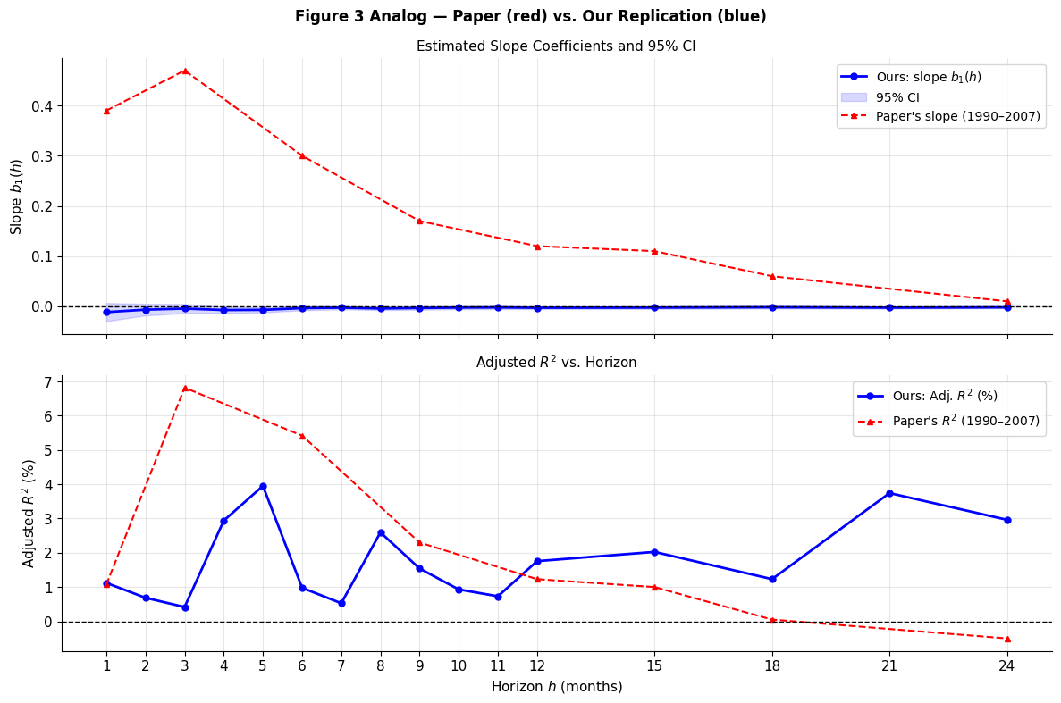
Financial Engineering · Lecture 07
3. Statistical Validation
Estimated Slopes and R² Across Horizons: Paper vs. Ours
Top: Slope b₁(h) with 95% CI — paper (red ▲) is positive at all horizons; ours (blue ●) is negative. Bottom: Adj. R² — paper peaks at h=3 (6.82%); ours is flat.
Bollerslev, Tauchen & Zhou (2009) · Rev. Financial Studies 22(11)
15 / 32

Slide 16
Financial Engineering · Lecture 07
3. Statistical Validation
What Do We Actually See? The Sign Reversal Explained
Paper: 1990–2007 Finding
Ours: 2008–2026 Finding
h=3: b₁ = +0.47, t = +2.86, R² = 6.82%
Positive at every horizon: high VRP ⇒ high returns
Hump-shaped R²: peaks quarterly, decays at 12m
VRP AR(1) = 0.49: signal is persistent, predictable
h=3: b₁ = −0.005, t = −0.96, R² = 0.42%
Negative at every horizon: high VRP ⇒ bad returns
Flat R² profile (0.4%–3%), no quarterly hump
VRP AR(1) = −0.10: near-zero persistence
Three Observation Pairs Drive the Sign Reversal
Oct 2008 (VRP = +289, data artifact: 4 trading days only) → Nov 2008 = −7.9%: high VRP → big loss
Feb 2020 (VRP = +85, COVID fear spiked VIX before the crash) → Mar 2020 = −13.4%: high VRP → disaster
Mar 2020 (VRP = −509, realized vol exploded past implied) → Apr 2020 = +11.9%: low VRP → big gain
Key Takeaway: Regime Change in VRP Timing
1990–2007: fear spikes (high VRP) were forward-looking — followed by recovery. 2008–2026: fear spikes coincide with crashes already in progress, then recoveries follow the low-VRP crash month.
Bollerslev, Tauchen & Zhou (2009) · Rev. Financial Studies 22(11)
16 / 32

Slide 17
4
Position Sizing
Translating VRP into Trading Signals
17 / 32

Slide 18
Financial Engineering · Lecture 07
4. Position Sizing
Position Sizing: Binary and Scaled VRP Signals
Binary Signal
Scaled Signal (Z-score)
positionₜ = 1 if VRPₜ > 0
positionₜ = 0 otherwise
Logic: long S&P 500 when fear premium is positive
zₜ = (VRPₜ − μ_{36}) / σ_{36} (rolling 36-month)
positionₜ = clip(zₜ, 0, 2) / 2
Logic: proportional to how extreme VRP is
Signal | VRP > 0 fraction | Avg Position | VRP>0 months: return/mo | VRP<0 months: return/mo
Binary | 85.2% (178/209 months) | 0.85 | +1.03% (+12.4% ann.) | −0.27% (−3.2% ann.)
Scaled | Same VRP sign | 0.10 | (proportional) | (proportional)
No-Lookahead Enforcement
Conditional Returns (Contemporaneous)
positionₜ is computed at month-end t
Applied to return r_{t+1} via .shift(1) in backtest
VRPₜ uses only data available at t ✓
VRP>0 months average +1.03%/mo — but this is same-month!
Contemporaneous comparison ≠ predictive regression
Next-month conditioning is the correct test (Section 3)
Bollerslev, Tauchen & Zhou (2009) · Rev. Financial Studies 22(11)
18 / 32

Slide 19
5
Backtest
Portfolio Performance: VRP Timing vs. Buy & Hold
19 / 32

Slide 20
Financial Engineering · Lecture 07
5. Backtest
Backtest Performance: 2008–10 to 2026–02 (N = 209 months)
Metric | Buy & Hold | VRP Binary | VRP Scaled | Binary vs. B&H
Ann. Return (%) | 10.08 | 9.60 | 0.87 | −0.48%
Ann. Volatility (%) | 14.87 | 12.84 | 4.67 | −2.03%
Sharpe Ratio | 0.68 | 0.75 | 0.19 | +0.07
Max Drawdown (%) | −29.4 | −22.6 | −20.9 | +6.8 pp
Hit Rate (%) | 64.6 | 55.3 | 33.0 | −9.3 pp
0.75
0.68
−22.6%
−29.4%
VRP Binary Sharpe
Buy & Hold Sharpe
VRP Binary Max DD
Buy & Hold Max DD
Mechanism: Tail-Risk Filter, Not Return Predictor
Strategy is flat 14.8% of months (VRP<0). Those 31 months include Nov 2008, Mar 2020, Aug 2011 — the worst episodes. Avoiding them reduces the left tail. Hit rate drops (55.3% vs 64.6%) because up-months are also missed. Net: modest Sharpe lift.
Bollerslev, Tauchen & Zhou (2009) · Rev. Financial Studies 22(11)
20 / 32

Slide 21
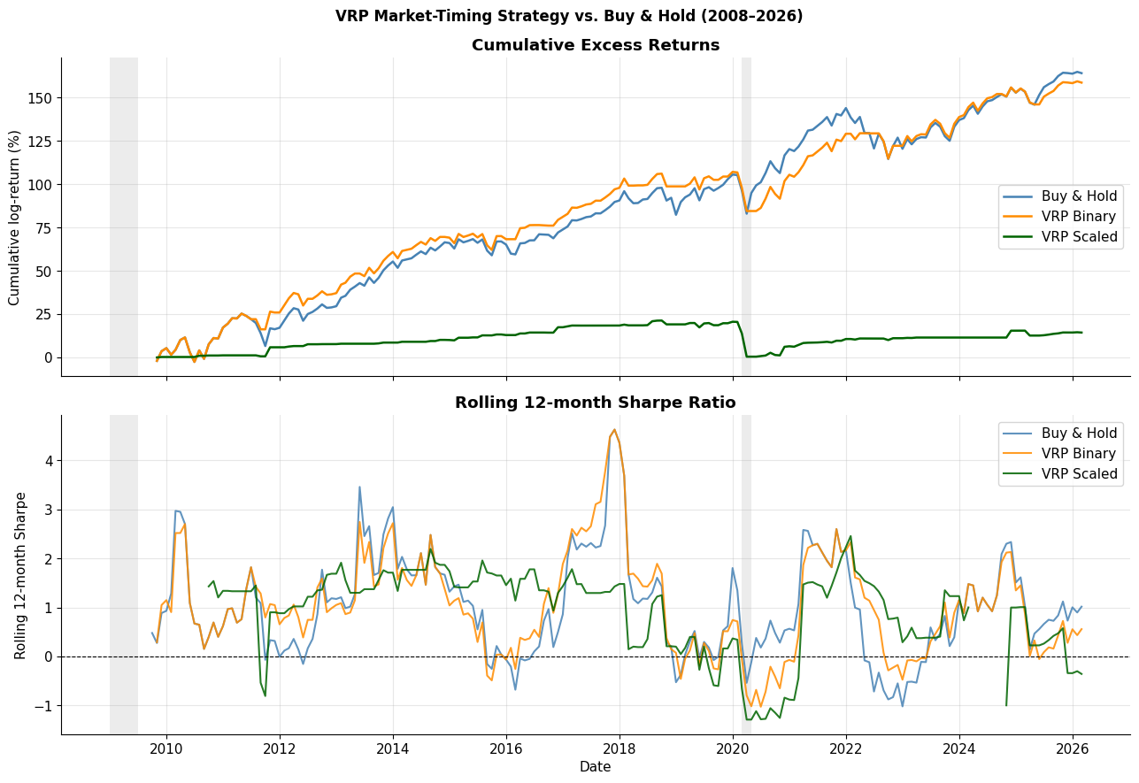
Financial Engineering · Lecture 07
5. Backtest
Cumulative Returns and Rolling 12-Month Sharpe Ratio
Top: Cumulative log-returns. VRP Binary (orange) closely tracks Buy & Hold (blue) with lower drawdown in 2009 and 2020. VRP Scaled (green) is much flatter. Bottom: Rolling 12-month Sharpe — Binary stays modestly above B&H through most windows.
Bollerslev, Tauchen & Zhou (2009) · Rev. Financial Studies 22(11)
21 / 32

Slide 22
6
Paper Comparison
Table 2 Replication: Slopes, t-stats, and R²
22 / 32

Slide 23
Financial Engineering · Lecture 07
6. Paper Comparison
Table 2 Replication: Bollerslev et al. (1990–2007) vs. Ours (2008–2026)
h | Paper b₁ | Our b₁ | Paper t | Our t | Paper R²% | Our R²%
1 | +0.39 | −0.012 | +1.76 | −1.24 | 1.07 | 1.12
3 | +0.47 | −0.005 | +2.86 | −0.96 | 6.82 | 0.42
6 | +0.30 | −0.004 | +2.15 | −1.64 | 5.42 | 0.98
9 | +0.17 | −0.003 | +1.36 | −1.82 | 2.30 | 1.54
12 | +0.12 | −0.003 | +1.00 | −2.18 | 1.23 | 1.76
Green = positive (paper direction). Red = negative (our direction). H=3 is the paper’s peak: R² drops from 6.82% to 0.42% in our sample.
Shape Comparison
Causes
Paper: hump-shaped R² peaking at h=3, then decaying
Ours: flat/slightly rising R² from h=1 to h=24 (0.4%→3.0%)
Both the magnitude AND the shape fail to replicate
(1) Wrong sample epoch — dominant driver
(2) Oct 2008 partial-month artifact
(3) Feb–Mar 2020 outlier pair
(4) Daily vs 5-min RV (noise, not sign)
Bollerslev, Tauchen & Zhou (2009) · Rev. Financial Studies 22(11)
23 / 32

Slide 24
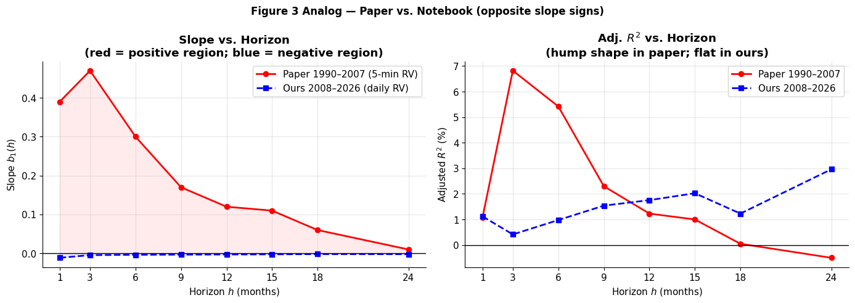
Financial Engineering · Lecture 07
6. Paper Comparison
Slope and R² Profiles: Paper (Red) vs. Ours (Blue)
Left: slope b₁(h) — zero line cleanly separates both samples at all horizons. Right: adj. R²(h) — paper’s hump peaks at h=3; ours is flat. Both shape and sign differ.
Bollerslev, Tauchen & Zhou (2009) · Rev. Financial Studies 22(11)
24 / 32

Slide 25
7
Robustness Checks
Do Alternative Specifications Change the Sign?
25 / 32

Slide 26
Financial Engineering · Lecture 07
7. Robustness
Robustness Checks: Three Alternative Specifications
Check 1: Excluding October 2008
Check 2: Volatility Form √IV − √RV
Slope at h=1: −0.012 → −0.008 (less negative, but still negative)
Slope at h=3: −0.005 → −0.001 (near zero but still negative)
Slope at h=12: −0.003 → −0.003 (unchanged)
Verdict: Oct 2008 partly drives h=1; Feb–Mar 2020 dominates h=3+. Sign reversal is structural.
Paper (quarterly): t = 2.75, R² = 6.51% (vs 2.86 / 6.82% in variance form)
Our h=1: t = −0.46 | h=3: t = −0.63 | h=6: t = −1.03 | h=12: t = −1.62
Square root compresses outlier magnitudes but does not change sign
Verdict: all slopes remain negative across all horizons
Check 3: HAR-RV Expected VRP (EVRP) — Nearly Replicates the Paper!
Replace raw RVₜ with a HAR-RV forecast: EVRPₜ = IVₜ − Eₜ[RV_{t+1}] (Corsi 2004 model, R² = 0.35)
EVRP mean = 9.28, std = 25.50, AR(1) = 0.23 — smoothing restores partial signal persistence
h = 3: t = +2.79, R² = 5.91% — nearly matches paper (t = 2.86, R² = 6.82%)
h = 6: t = +2.99, R² = 6.38% — even stronger. h = 12: t = +2.47, R² = 4.97%
Robustness Conclusion
EVRP (smoothed RV) recovers the sign. Raw VRP reversal = RV crash noise, not a structural IV-return change.
Bollerslev, Tauchen & Zhou (2009) · Rev. Financial Studies 22(11)
26 / 32

Slide 27
8
Honest Assessment
What This Replication Can and Cannot Support
27 / 32

Slide 28
Financial Engineering · Lecture 07
8. Honest Assessment
Honest Assessment: Paper vs. Notebook
Result | Paper (1990–2007) | Our Notebook (2008–2026) | Verdict
VRP Sign + Persistence | Mean=18.3, AR(1)=0.49 | Mean=9.0, AR(1)=−0.10 | Sign ✓, persistence ✗
Quarterly prediction | b₁=+0.47, t=+2.86, R²=6.82% | b₁=−0.005, t=−0.96, R²=0.42% | SIGN REVERSED
Hump-shaped R² | Peaks at h=3 then decays | Flat 0.4%–3.0%, no hump | Shape fails ✗
Backtest Sharpe | Implied ~2× uplift | 0.68 → 0.75 (+0.07) | Modest improvement ∼
Max Drawdown | Not reported | −29.4% → −22.6% | Real improvement ✓
EVRP check | t=2.27, R²=4.27% (h=3) | t=2.79, R²=5.91% (h=3) | Replicates! ✓
What the Data Supports
VRP is positive 85% of months (variance insurance premium is real). Avoiding VRP-negative months reduces max drawdown by 6.8 pp. HAR-RV smoothing recovers the paper’s quarterly predictability signal (EVRP t=2.79).
Bollerslev, Tauchen & Zhou (2009) · Rev. Financial Studies 22(11)
28 / 32

Slide 29
Financial Engineering · Lecture 07
8. Honest Assessment
Why Replication Fails: Structural Reasons and the Broader Lesson
Source of Discrepancy | Direction of Effect | Magnitude
Sample epoch (2008–2026 vs. 1990–2007) | Reverses sign (dominant) | Dominant
Oct 2008 partial-month artifact (4 trading days) | Worsens h=1 negative slope | Large
Feb–Mar 2020 outlier pair (COVID crash + recovery) | Drives negative h=3 to h=12 | Large
Daily vs 5-minute realized variance | Weakens signal (noise), not sign | Moderate
Newey–West vs. Hodrick (1992) standard errors | Slightly different t-stats | Small
Fed Funds vs. 3-month T-bill as risk-free rate | Negligible in low-rate era | Very small
The Broader Lesson: Sample Sensitivity in Empirical Asset Pricing
The paper’s 1990–2007 regime had: (1) moderate persistent VRP (AR1=0.49), (2) no single catastrophic outlier pair, (3) fear spikes followed by recovery returns.
Our 2008–2026 regime has: near-zero VRP persistence, extreme outlier pairs dominating the regression, and fear spikes that immediately precede crashes rather than predict recoveries.
Bollerslev, Tauchen & Zhou (2009) · Rev. Financial Studies 22(11)
29 / 32

Slide 30
Financial Engineering · Lecture 07
Key Takeaways
Key Takeaways
1
VRP = IV − RV is theoretically motivated: Epstein–Zin preferences with stochastic vol-of-vol (q_t) create an equity premium component measured exactly by the VRP spread.
2
The paper finds peak predictability at h=3: b₁=+0.47, t=+2.86, R²=6.82% for 1990–2007 — the VRP-return relationship is positive and significant at the quarterly horizon.
3
Our 2008–2026 replication finds the exact opposite: all slopes negative. Two outlier pairs (Oct–Nov 2008; Feb–Mar 2020) run the regression in reverse and dominate the 209-month sample.
4
VRP AR(1) collapses from 0.49 (paper) to −0.10 (ours) — near-zero persistence is inconsistent with the model’s persistent q_t assumption and makes the signal unreliable.
5
The VRP Binary strategy improves Sharpe from 0.68 to 0.75 and cuts max drawdown from −29.4% to −22.6%, but by avoiding the 14.8% of crash months, not by predicting returns.
6
HAR-RV Expected VRP recovers the paper’s finding: EVRP at h=3 gives t=+2.79, R²=5.91% — smoothing realized variance restores predictability even in the post-2008 sample.
7
Regime sensitivity is the central lesson. Out-of-sample testing in a structurally different epoch is as informative as the original result — both findings are true within their own epoch.
Bollerslev, Tauchen & Zhou (2009) · Rev. Financial Studies 22(11)
30 / 32

Slide 31
Financial Engineering · Lecture 07
Discussion
Discussion Questions
1
The paper stopped at December 2007 to avoid the GFC. Is this a strength (clean signal, pre-crisis) or a limitation (implicit sample selection / p-hacking risk)? How would you test for this?
2
If you were managing a volatility fund in 2008, would you continue using the VRP signal after the October 2008 partial-month artifact? Design a real-time monitoring rule that would have flagged this observation.
3
The EVRP (using HAR-RV forecast of RV) nearly replicates the paper’s result even in our post-2008 sample (t=2.79 vs. 2.86). Why might replacing realized with expected RV recover predictability?
4
VRP AR(1) drops from 0.49 (paper) to −0.10 (ours). Which structural changes — options market microstructure, QE/central bank intervention, index products growth — could explain this collapse in persistence?
5
Design a robustness test to determine whether the 2008 and 2020 outlier pairs are the sole drivers of the negative slope, or whether the post-2008 regime shift produces a different result even when those specific months are excluded.
Bollerslev, Tauchen & Zhou (2009) · Rev. Financial Studies 22(11)
31 / 32

Slide 32
Financial Engineering · Lecture 07
References
[L] Bollerslev, T., Tauchen, G., & Zhou, H. (2009). Expected stock returns and variance risk premia. Review of Financial Studies, 22(11), 4463–4492.
[M] Corsi, F. (2004). A simple approximate long-memory model of realized volatility. Journal of Financial Econometrics, 7(2), 174–196.
[M] Epstein, L. G., & Zin, S. E. (1989). Substitution, risk aversion, and the temporal behavior of consumption and asset returns. Econometrica, 57(4), 937–969.
[H] Bozovic, M. (2024). VIX-managed portfolios. Working paper.
Thank You
Bollerslev, Tauchen & Zhou (2009) · Rev. Financial Studies 22(11)
32 / 32

